Slide 1
Programming Fundamentals
Lecture 18
Ms. Farah Younas

Slide 2
Agenda of Lecture
Passing arguments
Returning value to calling function
Pass by value
Pass by reference
Overloaded function

Slide 3
Passing constants vs Passing variables
‘–’, 43 : the arguments were constants
instead of constants variables are passed as arguments
the user specify the character and the number of times it should be repeated
Here’s some sample interaction with VARARG:
Enter a character: +
Enter number of times to repeat it: 20

Slide 4
Passing constants vs Passing variables
The data types of variables used as arguments must match those specified in the function declaration and definition, just as they must for constants.
That is, chin must be a char, and nin must be an int.

Slide 5
Returning value from a function
When a function completes its execution, it can return a single value to the calling program.
this return value consists of an answer to the problem the function has solved
The next example demonstrates a function that returns a weight in kilograms after being given a weight in pounds

Slide 6
Returning value from a function
When a function returns a value, the data type of this value must be specified.
The function declaration does this by placing the data type, float in this case, before the function name in the declaration and the definition.
Functions in earlier program examples returned no value, so the return type was void.
the function lbstokg() (pounds to kilograms, where lbs means pounds) returns type float,so the declaration is
float lbstokg(float);

Slide 7
Returning value from a function – return statement
The function lbstokg() is passed an argument representing a weight in pounds, which it stores in the parameter pounds.
It calculates the corresponding weight in kilograms by multiplying this pounds value by a constant; the result is stored in the variable kilograms.
The value of this variable is then returned to the calling program using a return statement:

Slide 8
Passing by value
values possessed by chin and nin when the function call is executed will be passed to the function.
when constants were passed to it, the function creates new variables to hold the values of these variable arguments
The function gives these new variables the names and data types of the parameters specified in the declarator: ch of type char and n of type int.

Slide 9
Passing by value
It initializes these parameters to the values passed.
They are then accessed like other variables by statements in the function body.
Passing arguments in this way, where the function creates copies of the arguments passed to it, is called passing by value.

Slide 10
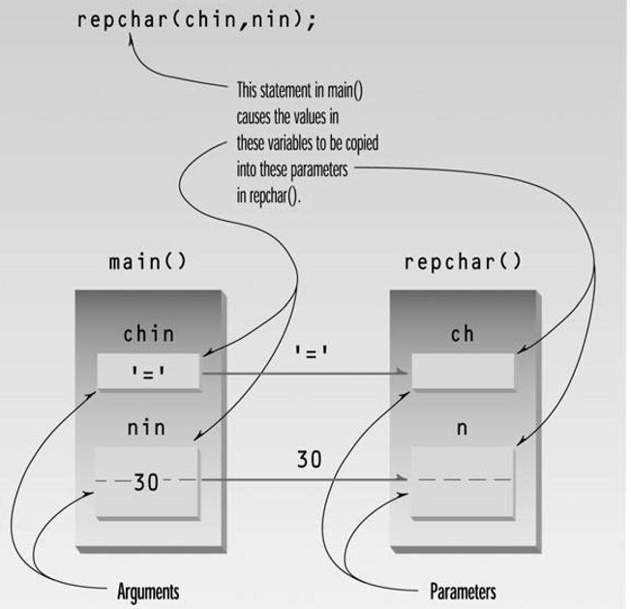

Slide 11
Passing by reference
A reference provides an alias—a different name—for a variable. One of the most important uses for references is in passing arguments to functions.
When arguments are passed by value, the called function creates a new variable of the same type as the argument and copies the argument’s value into it

Slide 12
Passing by reference
the function cannot access the original variable in the calling program, only the copy it created.
Passing arguments by value is useful when the function does not need to modify the original variable in the calling program

Slide 13
Passing by reference
the function cannot access the original variable in the calling program, only the copy it created.
Passing arguments by value is useful when the function does not need to modify the original variable in the calling program
Passing arguments by reference uses a different mechanism. Instead of a value being passed to the function, a reference to the original variable, in the calling program, is passed

Slide 14
Passing by reference
It’s actually the memory address of the variable that is passed.
An important advantage of passing by reference is that the function can access the actual variables in the calling program.
Among other benefits, this provides a mechanism for passing more than one value from the function back to the calling program.

